Slide 1


High Vocational School of transport, Razlog

Slide 2


Educational System of Bulgaria
Education in Bulgaria is mainly supported by the state through the Ministry of Education and Science. School education is compulsory for children from seven to sixteen years of age.
The Bulgarian educational system falls within the continental European tradition. The main types of secondary schools are general educational, vocational, language schools and foreign schools. Private schools are also being established and they are beginning to compete successfully with state schools.
There are fifty-one higher educational institutions in Bulgaria offering degrees at undergraduate and graduate levels. The academic year for most Bulgarian universities begins around October 1 and consists of fall and spring semesters. The academic year covers up to 30 weeks. Classes usually meet once a week for 75 minutes or for two 45-minute periods with a 15-minute break in between.
Notes:
Notes to presenter:
Description of what you learned in your own words on one side.
Include information about the topic
Details about the topic will also be helpful here.
Tell the story of your learning experience. Just like a story there should always be a beginning, middle and an end.
On the other side, you can add a graphic that provides evidence of what you learned.
Feel free to use more than one slide to reflect upon your process. It also helps to add some video of your process.
2

Slide 3
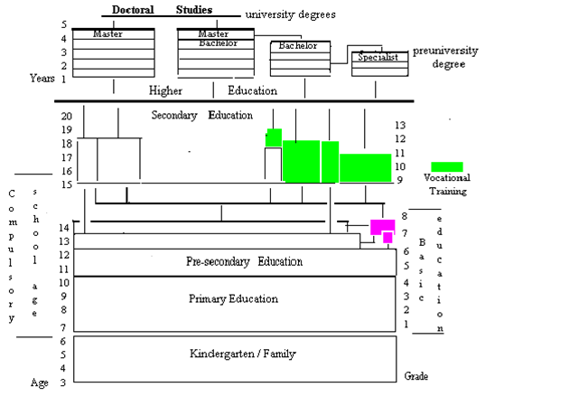
Educational System of Bulgaria – structure
Notes:
Notes to presenter:
Description of what you learned in your own words on one side.
Include information about the topic
Details about the topic will also be helpful here.
Tell the story of your learning experience. Just like a story there should always be a beginning, middle and an end.
On the other side, you can add a graphic that provides evidence of what you learned.
Feel free to use more than one slide to reflect upon your process. It also helps to add some video of your process.
3

Slide 4
Languages of Study
The official language of instruction is Bulgarian.
At the school level, the general curriculum provides opportunities for ethnic minority children to study their mother tongue.
In specialized language schools and in the profile-oriented schools, instruction takes place in English, German, Italian, French, Spanish, Armenian, Hebrew, Russian, and other languages.
At university level, instruction takes place in English at the American University in Bulgaria, and in German, French and English in some programs in technical universities.
Notes:
Notes to presenter:
Description of what you learned in your own words on one side.
Include information about the topic
Details about the topic will also be helpful here.
Tell the story of your learning experience. Just like a story there should always be a beginning, middle and an end.
On the other side, you can add a graphic that provides evidence of what you learned.
Feel free to use more than one slide to reflect upon your process. It also helps to add some video of your process.
4

Slide 5
Primary and Secondary Education: General
Authority: The Ministry of Education and Science
Web site in Bulgarian: www.minedu.government.bg
The Ministry of Education and Science creates and applies national education policy, and also plans and organizes the development of education by putting together long-term programs and operational projects.
Education in Bulgaria is compulsory from the ages of 7 to 16. Children complete their compulsory education in upper secondary schools.
Structure
  Basic education (Grades 1-8) in Bulgaria comprises primary school (grades 1-4) and pre-secondary school (grades 5-8).
  The Upper Secondary level lasts for either 4 or 5 years following the receipt of a Basic Education Completion Certificate. Upper Secondary education is provided in three types of schools: comprehensive (general) secondary schools, profile-oriented schools and vocational-technical schools.
Notes:
Notes to presenter:
Description of what you learned in your own words on one side.
Include information about the topic
Details about the topic will also be helpful here.
Tell the story of your learning experience. Just like a story there should always be a beginning, middle and an end.
On the other side, you can add a graphic that provides evidence of what you learned.
Feel free to use more than one slide to reflect upon your process. It also helps to add some video of your process.
5

Slide 6
Higher Education
Ministry of Education and Science manages the higher education system in Bulgaria. Higher education in Bulgaria is provided by public as well as private higher education institutions, which include universities, independent colleges and specialized higher schools.
Students who hold the diploma of secondary education/specialized secondary education are eligible to apply for higher education in Bulgaria.
Notes:
Notes to presenter:
Description of what you learned in your own words on one side.
Include information about the topic
Details about the topic will also be helpful here.
Tell the story of your learning experience. Just like a story there should always be a beginning, middle and an end.
On the other side, you can add a graphic that provides evidence of what you learned.
Feel free to use more than one slide to reflect upon your process. It also helps to add some video of your process.
6

Slide 7
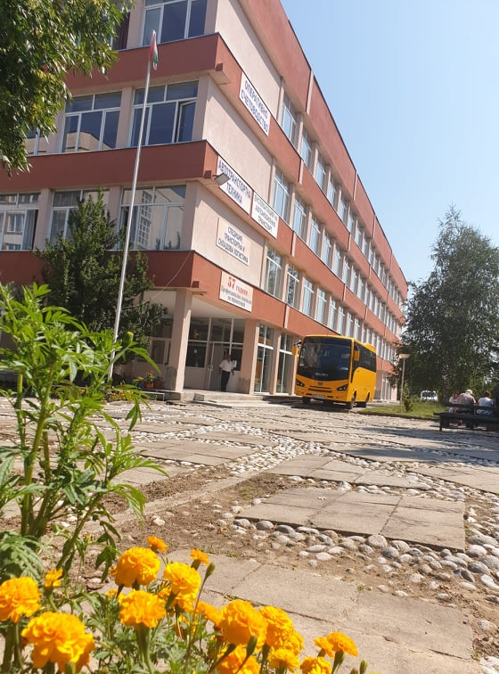
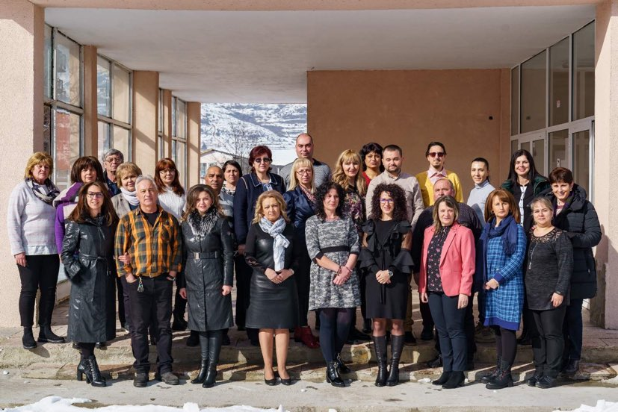
High Vocational School of transport

Slide 8

High Vocational School of transport
High Vocational School of transport is a Bulgarian state school, situated in a town of Razlog. It is in a valley among three mountains in the south west of Bulgaria. It has got very good road connections, 150 km from Sofia - the capital of Bulgaria. The school has the capacity to educate 500 students but this year they are 250. Our students are 14 to 18 years of age. 31 teachers. Besides regular students we have part-time students, who work and study at the same time. It is multicultural and multi religious society at school. There are sports clubs and language clubs and cultural heritage clubs at school. There is also a Students‘ Council and Parents‘ Council. Some students come from families with low income and low level of parents’ education. Part of the students travel every day, and we have a school bus. We work close with families, different organizations and NGOs. Most of our students are motivated and hard working. The students participate in events and competitions at regional, national and international level. We work close with business sectors. Our senior students do practical education out of school in business companies. Our graduates are awarded 3rd professional level out of 4 in Bulgaria. They can immediately start work or continue their education in any college or university in Bulgaria or abroad. Some of our students join labor market abroad. Others work for foreign companies in Bulgaria. That is why studying subjects as vocational English and vocational Russian is very important for them. During their last year they study professional English. Depending on the profession they study different professional English subject. Producing teaching materials and sharing good teaching practices, methodologies and information about CLIL with other schools will contribute to raise the level of the vocational education in our school. It will also make the school more attractive for new students and their families. We have experience in running EU educational projects – Leonardo and Comenius. We have experience also in students’ exchange and in Junior Achievement projects.
Notes:
Notes to presenter:
Description of what you learned in your own words on one side.
Include information about the topic
Details about the topic will also be helpful here.
Tell the story of your learning experience. Just like a story there should always be a beginning, middle and an end.
On the other side, you can add a graphic that provides evidence of what you learned.
Feel free to use more than one slide to reflect upon your process. It also helps to add some video of your process.
8

Slide 9
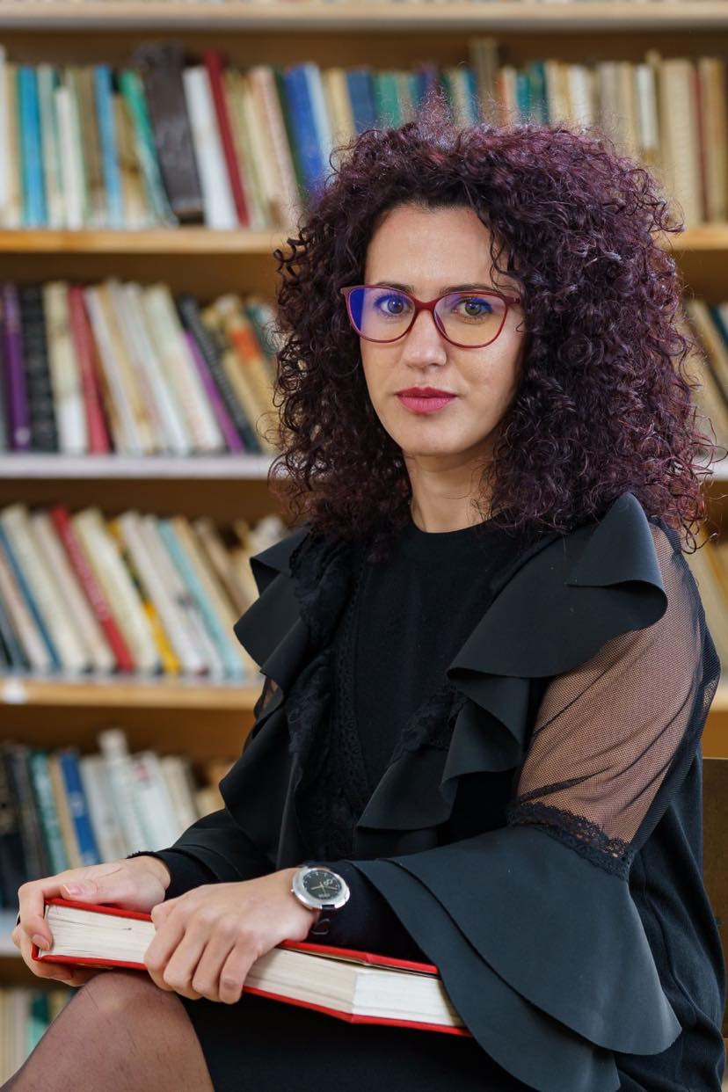
Our School Principal
PhD Magdalena Shekerliyska
26 August 2020 headmistress of the High Vocational school of transport, Razlog (PGT, Razlog)
Since 2012 she has been working as a chemistry teacher at High School of Natural Sciences and Mathematics “Acad. Sergey Korolyov”, Blagoevgrad and High School of Natural Sciences and Mathematics “Prof. Emanuil Ivanov ”, Kyustendil.
She obtained a PhD degree in February 2018 in the field of methodology of teaching chemistry. Her research interests are focused on the formation and development of scientific competence and on control and evaluation in education.
She has been working for 4 years at the South-West University "Neofit Rilski" as an assistant in methodological disciplines and inorganic chemistry, and also for 2 years as a lecturer in Methodology of teaching chemistry.

Slide 10
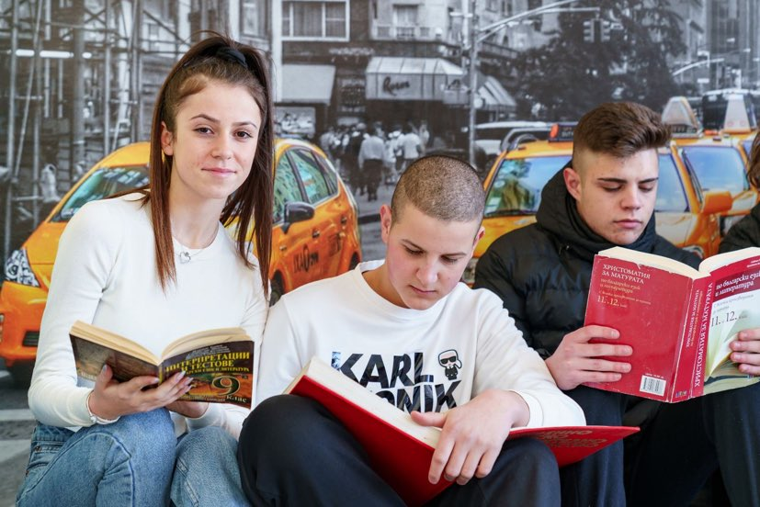
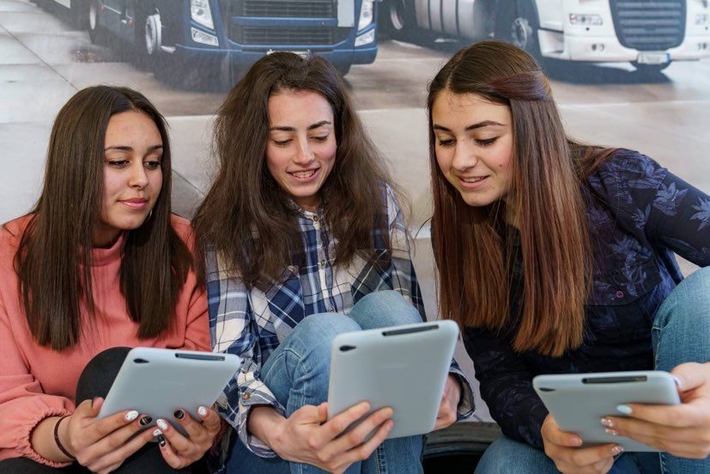
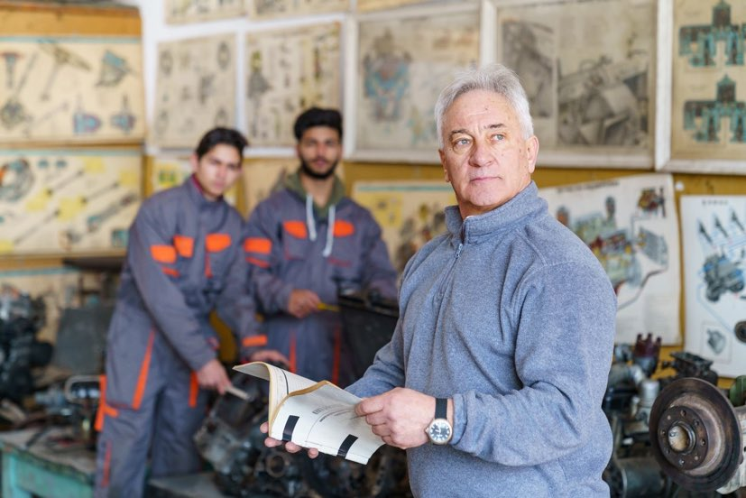
Our School Professions
Accounting
Logistic
Business administration
Motor and transport Equipment and Technology

Slide 11

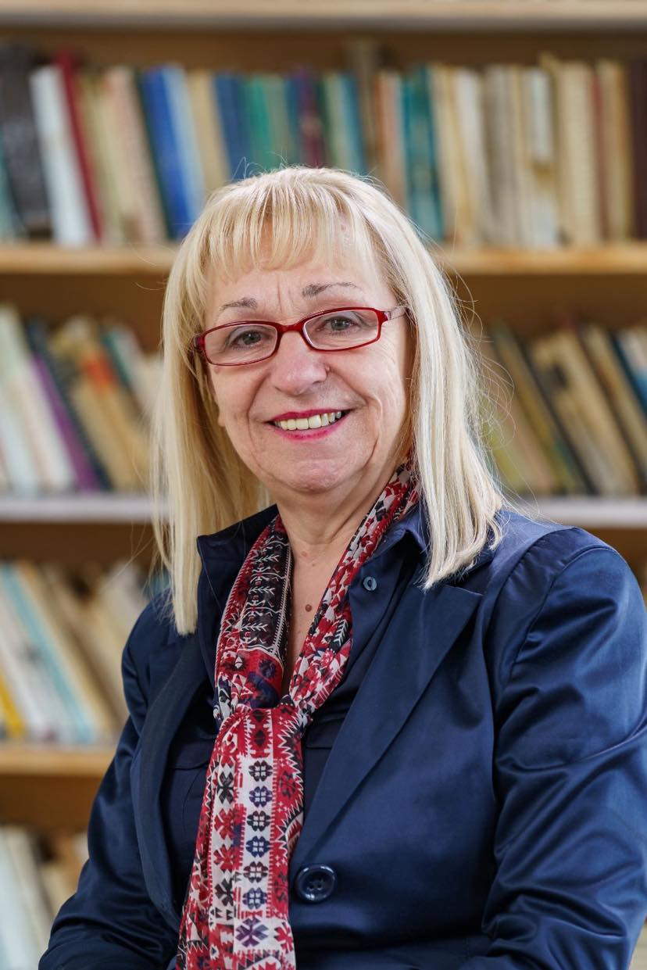
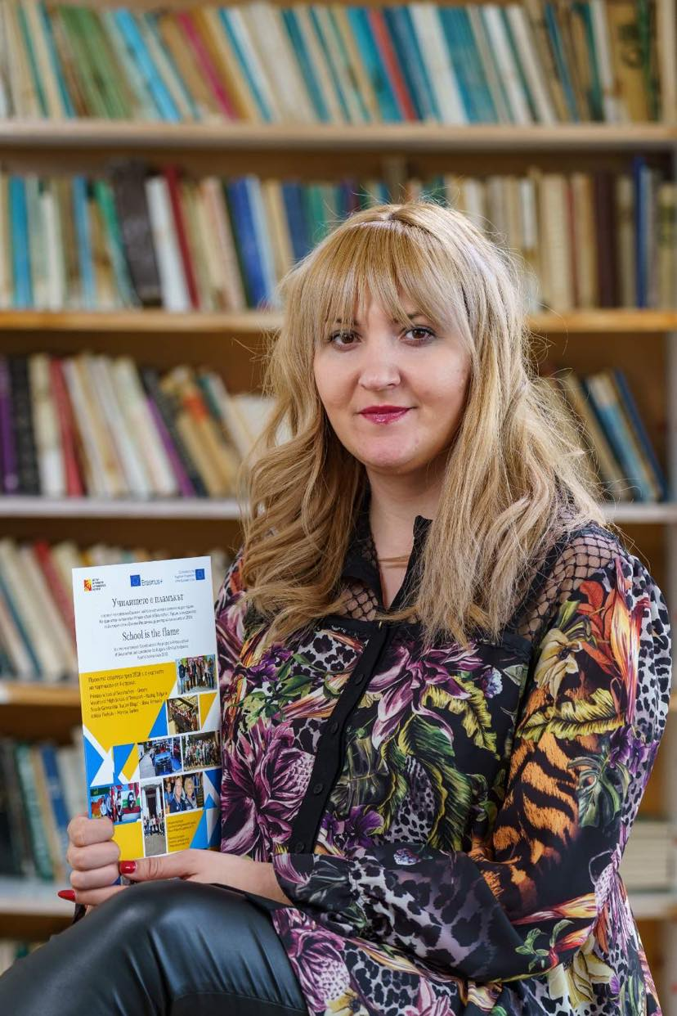
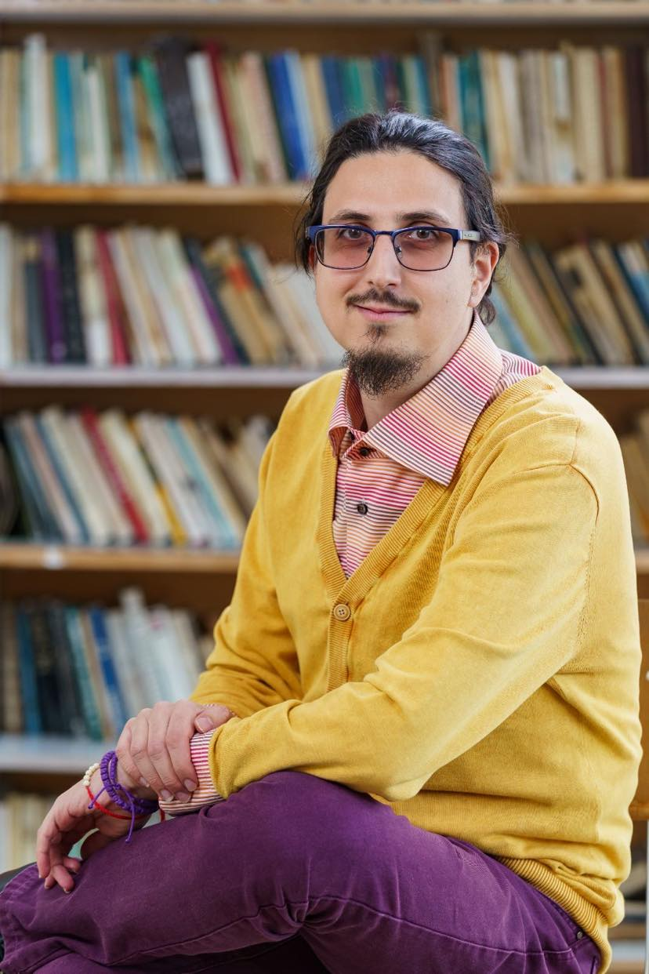



The Projects’ team and project activities
Notes:
Notes to presenter:
What is your purpose for sharing this reflection?
Is it at the end of a unit or project?
Are you sharing this reflection, at the attainment of a learning goal you set for yourself?
Is it at the end of a course?
State your purpose for the reflection or even the purpose of the learning experience or learning goal. Be clear and be specific in stating your purpose.
11

Slide 12
Zinaida Toncheva – Headteacher in English
Vasilena Stoilova – Assistant Headteacher in English
Todor Dzhumayliev – Assistant Headteacher in English

Slide 13
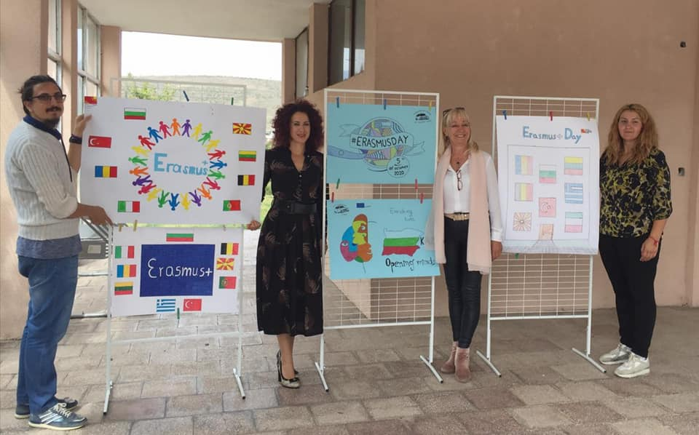
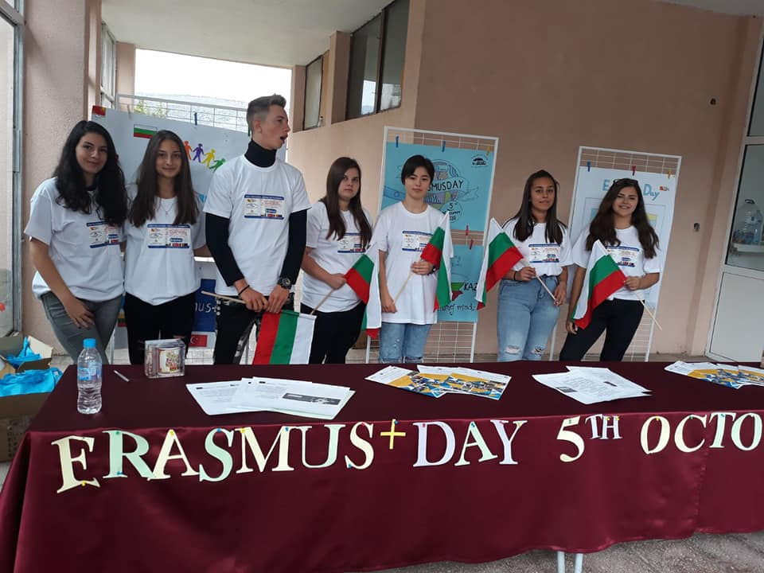
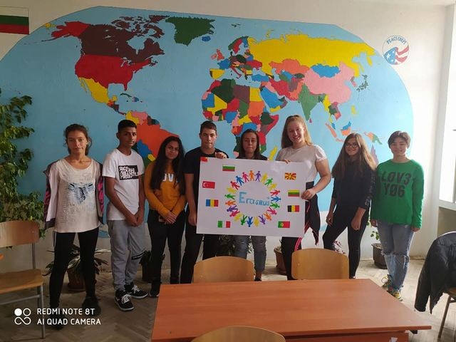
Notes:
Notes to presenter:
What was important about this learning experience?
How is it relevant to your course, yourself, or your society or community?
Why is this significant?
This SmartArt allows you add images and text to help outline your process. If a picture is worth a thousand words, then pictures and words should help you communicate this reflection on learning perfectly! You can always click on Insert>SmartArt to change this graphic or select the graphic and click on the Design contextual menu to change the colors.
13

Slide 14
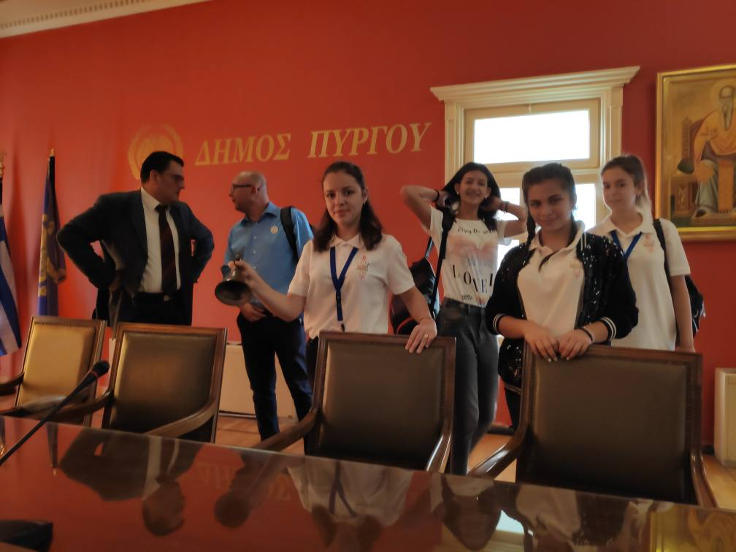
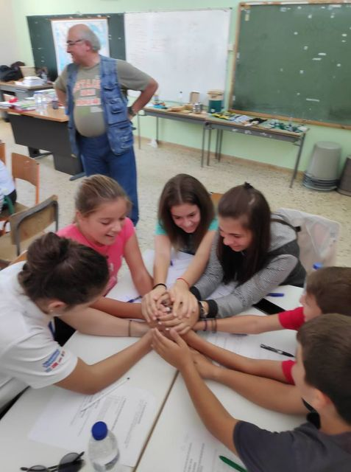
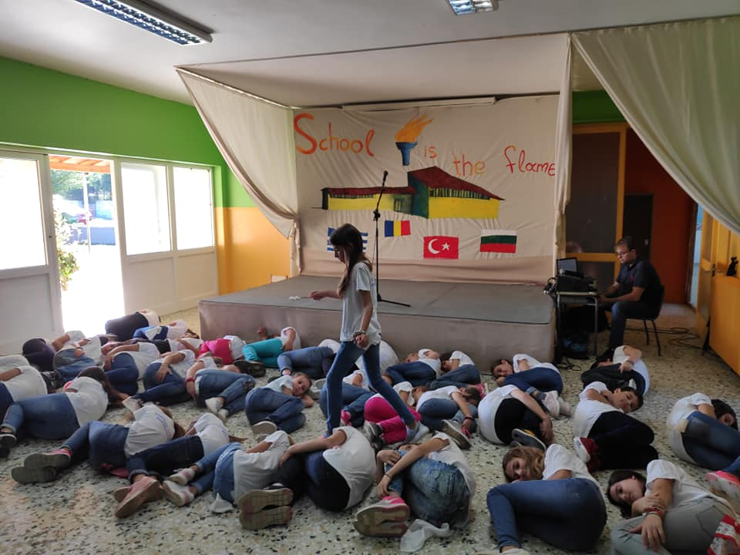
Notes:
Notes to presenter:
What was important about this learning experience?
How is it relevant to your course, yourself, or your society or community?
Why is this significant?
This SmartArt allows you add images and text to help outline your process. If a picture is worth a thousand words, then pictures and words should help you communicate this reflection on learning perfectly! You can always click on Insert>SmartArt to change this graphic or select the graphic and click on the Design contextual menu to change the colors.
14

Slide 15
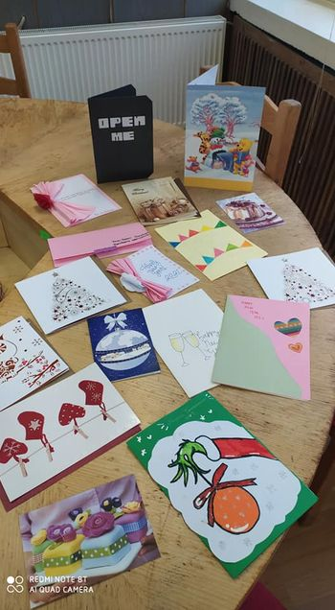
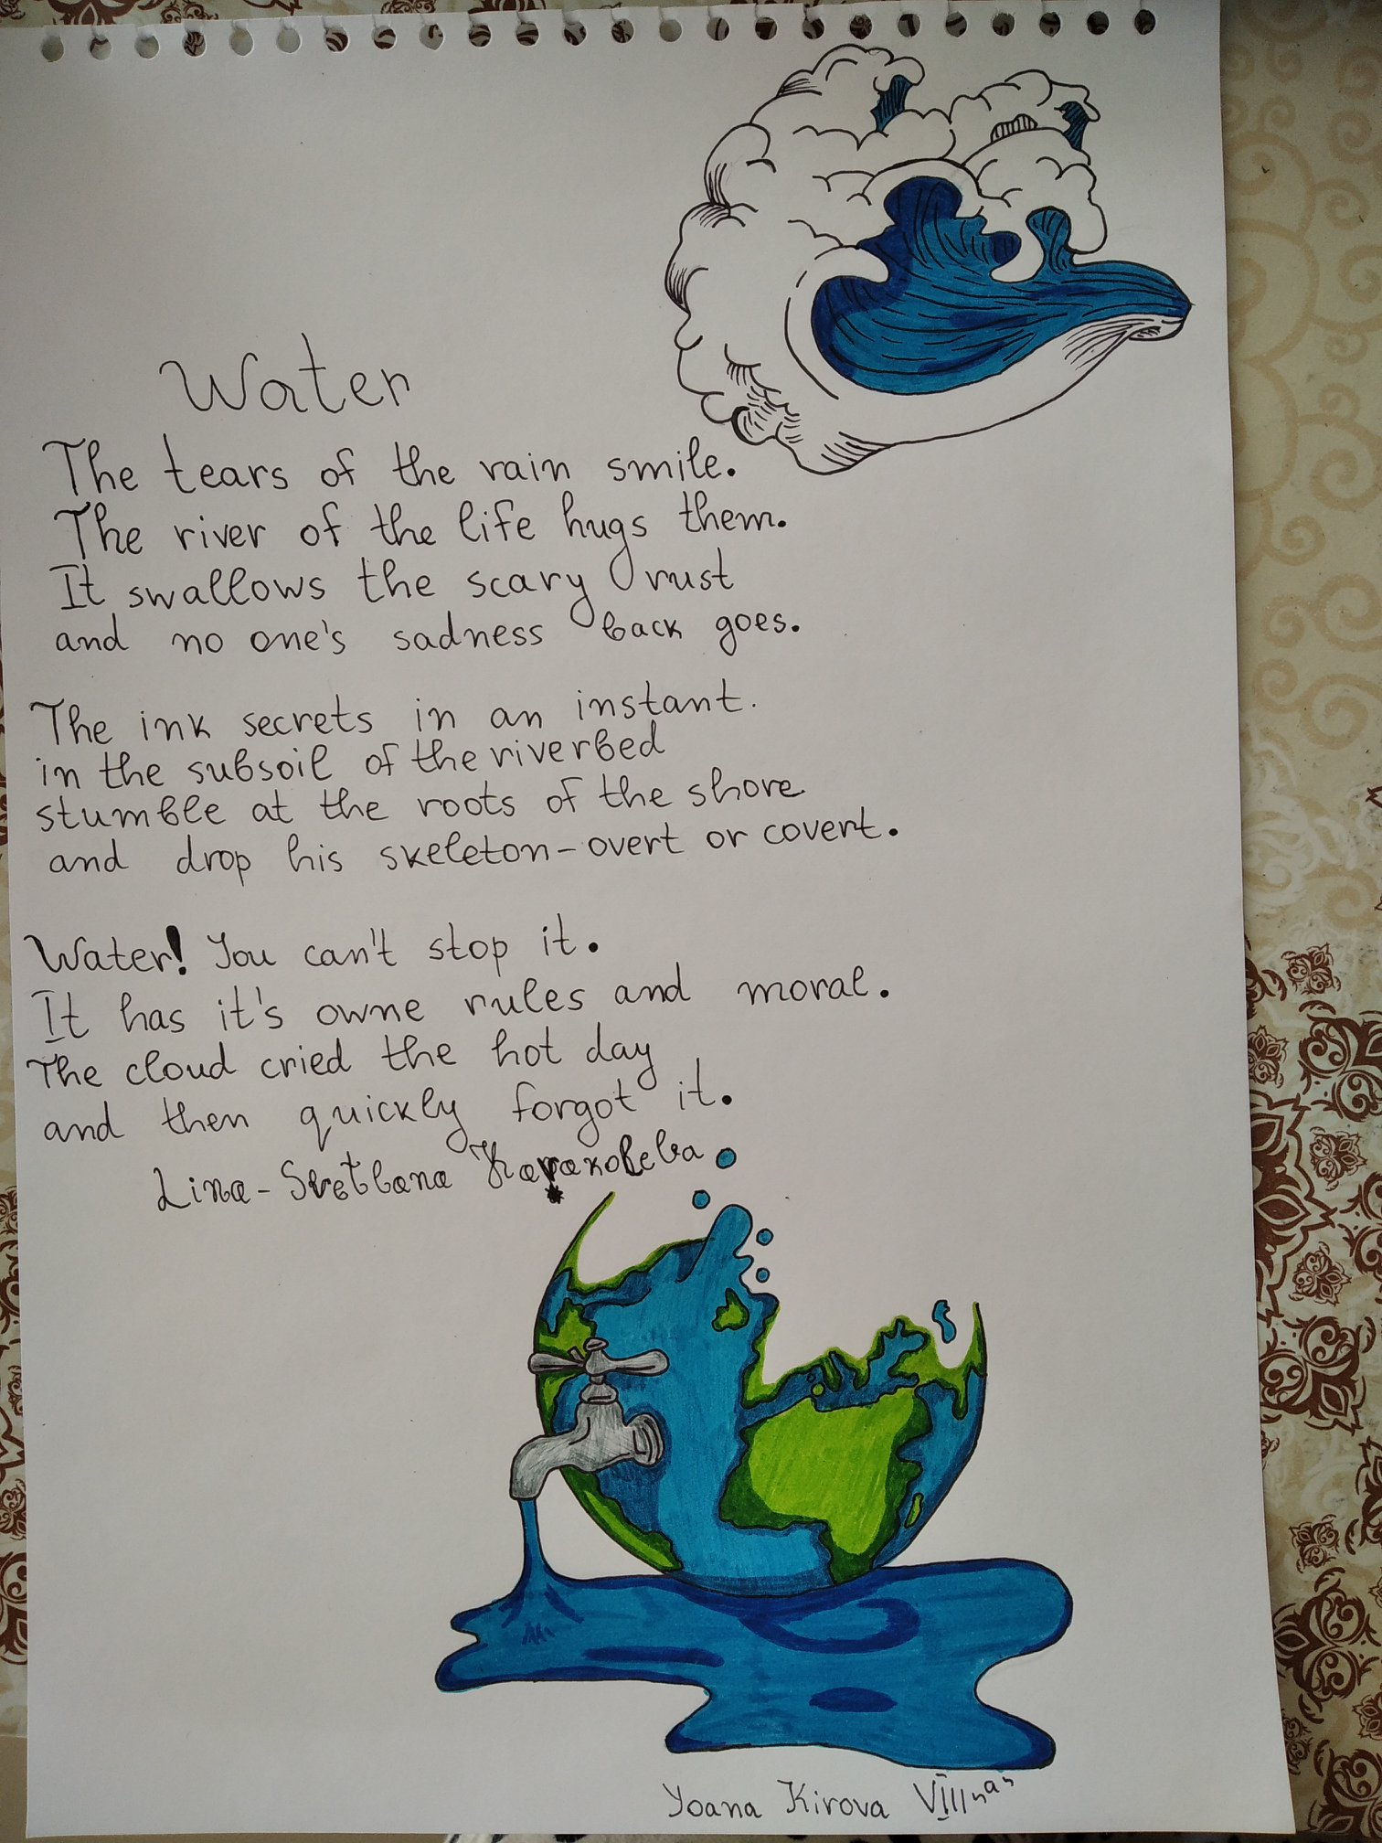
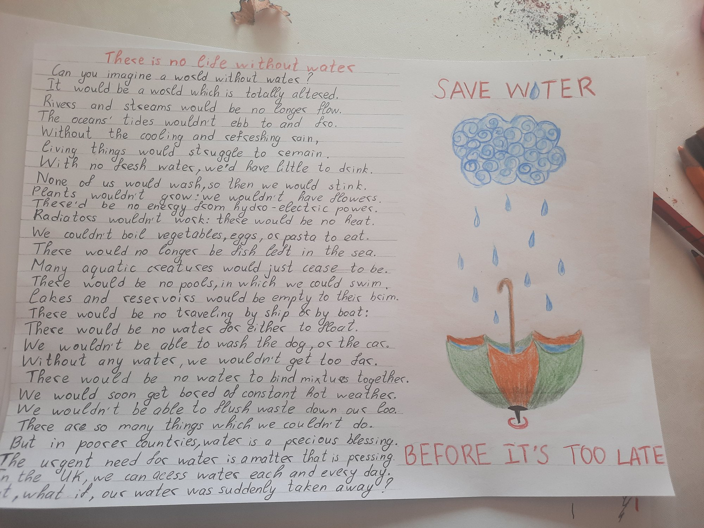
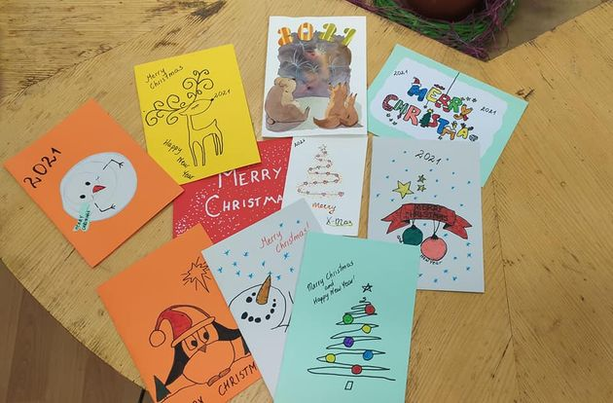
Notes:
Notes to presenter:
What was important about this learning experience?
How is it relevant to your course, yourself, or your society or community?
Why is this significant?
This SmartArt allows you add images and text to help outline your process. If a picture is worth a thousand words, then pictures and words should help you communicate this reflection on learning perfectly! You can always click on Insert>SmartArt to change this graphic or select the graphic and click on the Design contextual menu to change the colors.
15

Slide 16
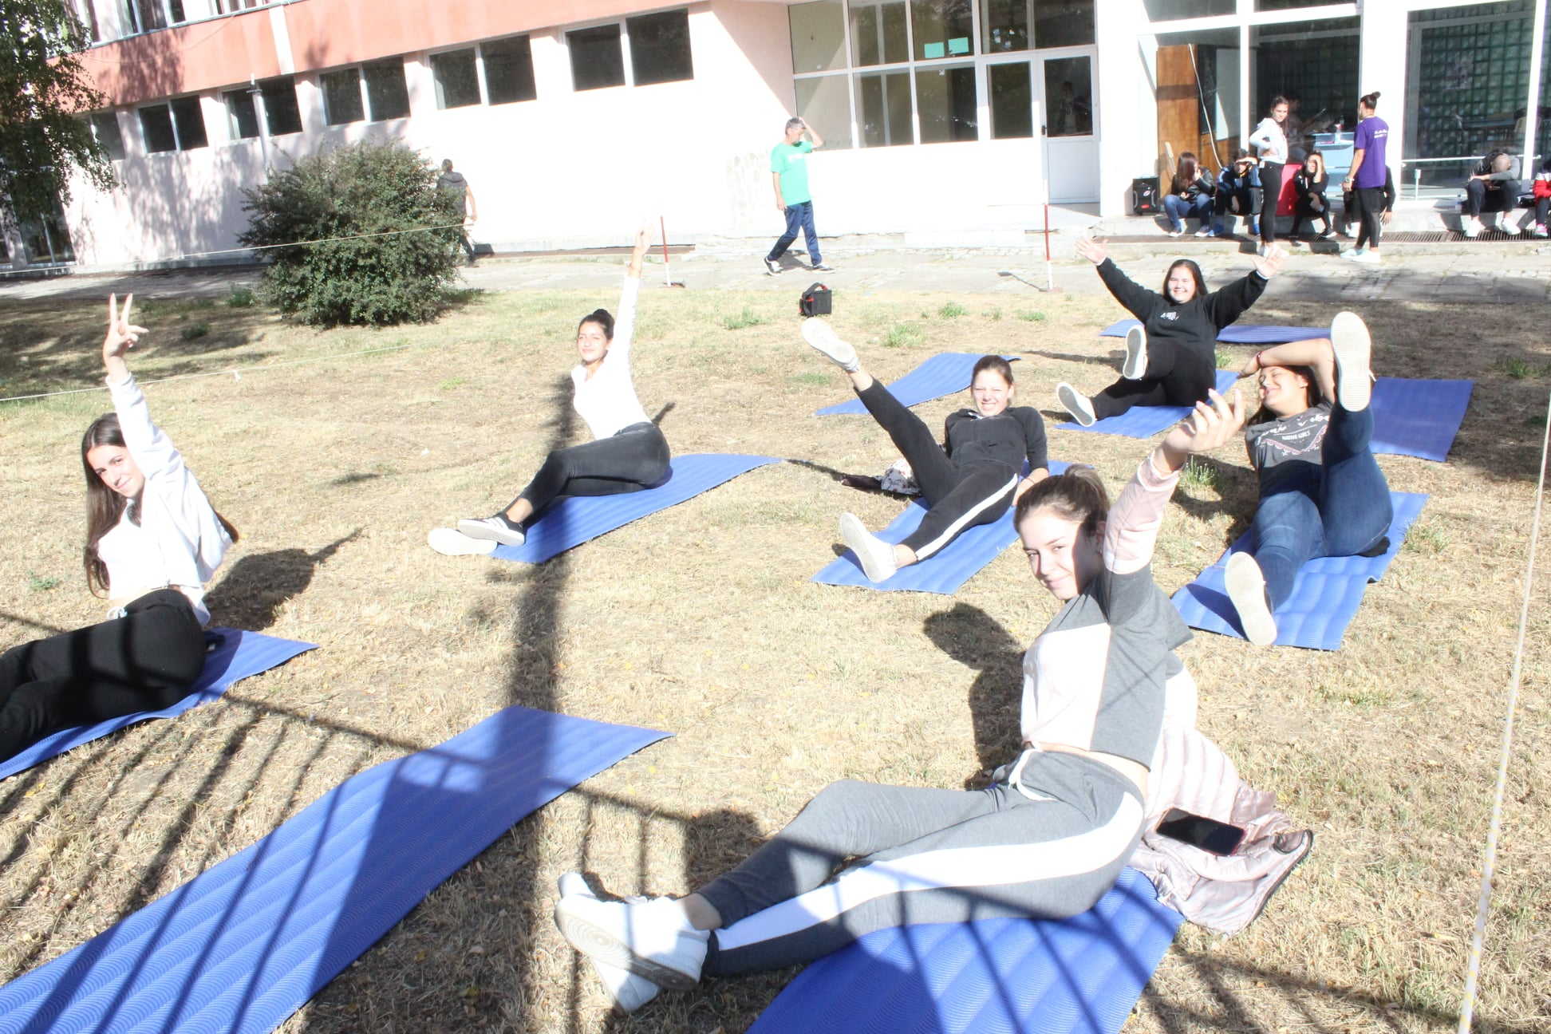
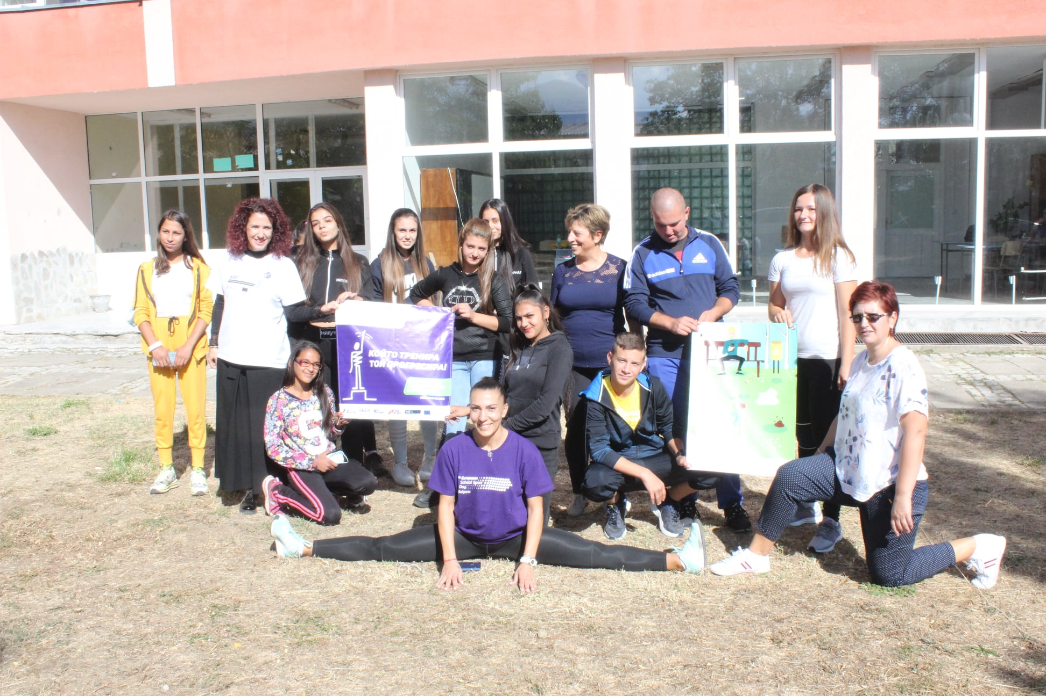
School activities
Notes:
Notes to presenter:
What is your purpose for sharing this reflection?
Is it at the end of a unit or project?
Are you sharing this reflection, at the attainment of a learning goal you set for yourself?
Is it at the end of a course?
State your purpose for the reflection or even the purpose of the learning experience or learning goal. Be clear and be specific in stating your purpose.
16

Slide 17
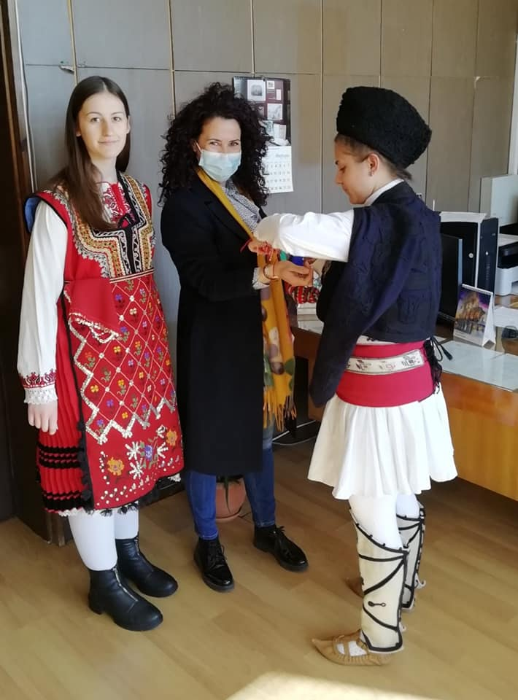
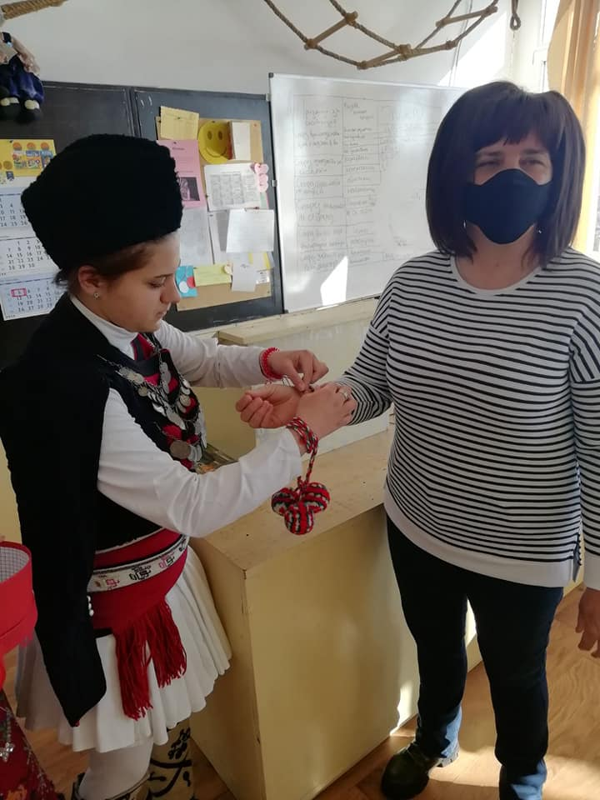
Notes:
Notes to presenter:
What is your purpose for sharing this reflection?
Is it at the end of a unit or project?
Are you sharing this reflection, at the attainment of a learning goal you set for yourself?
Is it at the end of a course?
State your purpose for the reflection or even the purpose of the learning experience or learning goal. Be clear and be specific in stating your purpose.
17

Slide 18
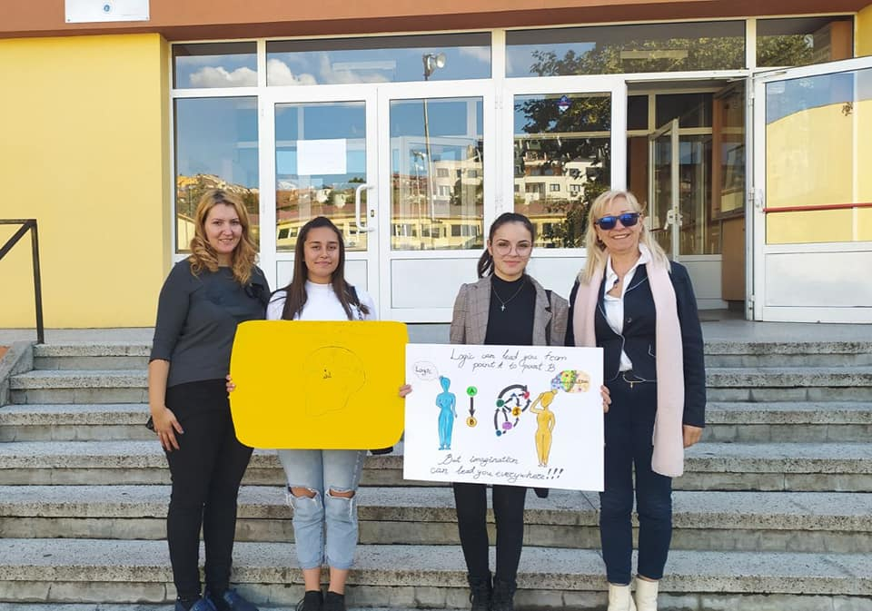
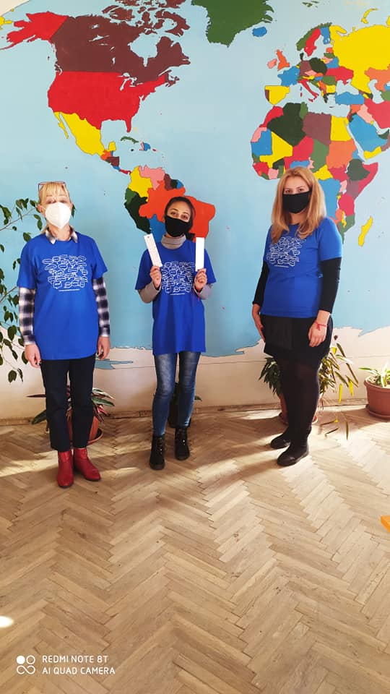
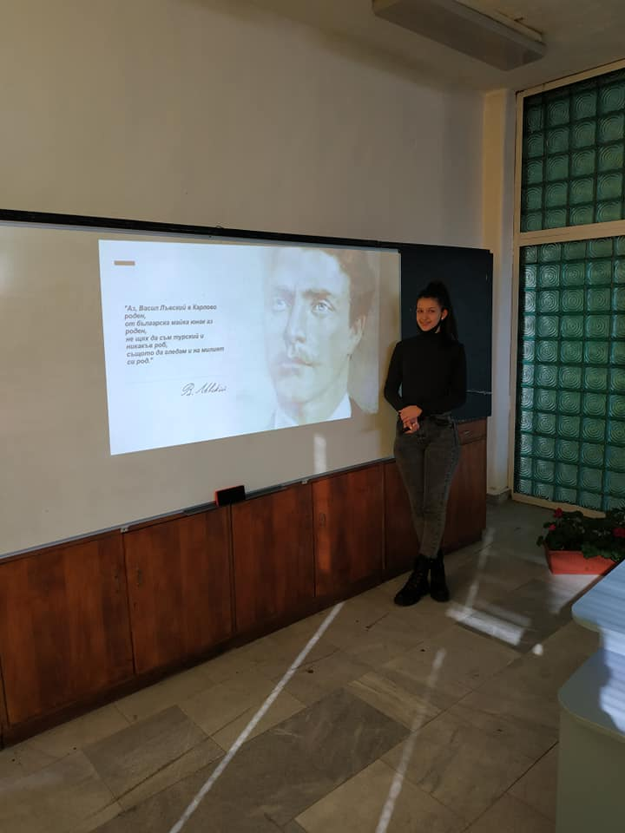
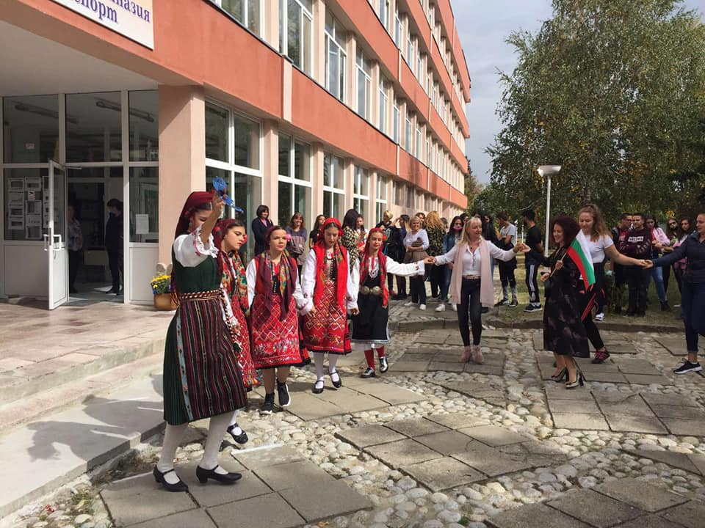
Notes:
Notes to presenter:
What is your purpose for sharing this reflection?
Is it at the end of a unit or project?
Are you sharing this reflection, at the attainment of a learning goal you set for yourself?
Is it at the end of a course?
State your purpose for the reflection or even the purpose of the learning experience or learning goal. Be clear and be specific in stating your purpose.
18

Slide 19
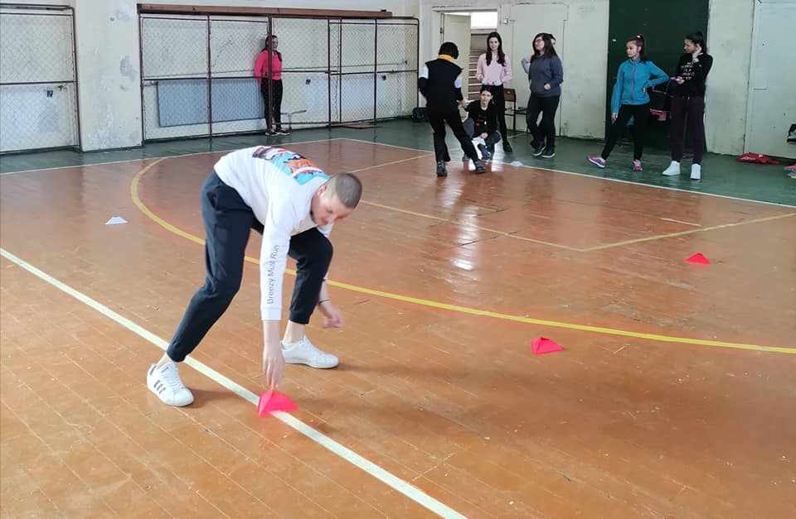
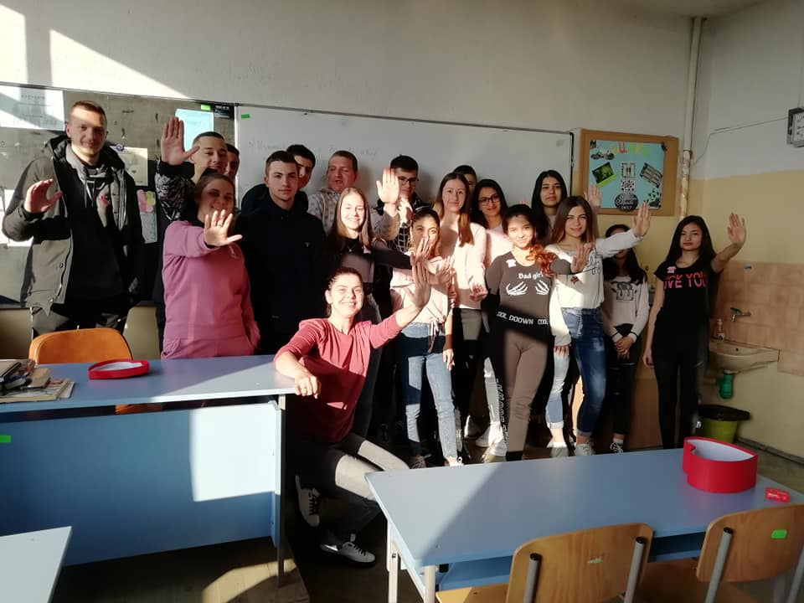
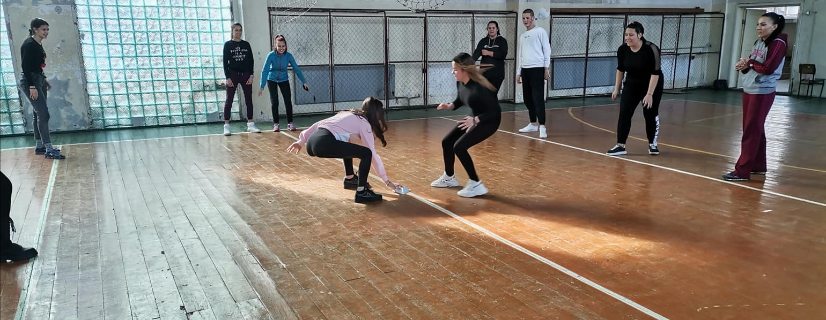
Notes:
Notes to presenter:
What is your purpose for sharing this reflection?
Is it at the end of a unit or project?
Are you sharing this reflection, at the attainment of a learning goal you set for yourself?
Is it at the end of a course?
State your purpose for the reflection or even the purpose of the learning experience or learning goal. Be clear and be specific in stating your purpose.
19

